Slide 1
Calcium Isotope Fractionation in Hip Bone and Serum
Lily Wayne
Steve Romaniello
Wang Zheng
Gwyneth Gordon
Ariel Anbar

Slide 2
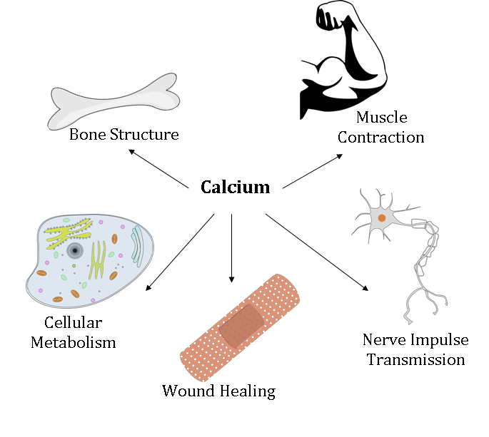
Importance of Calcium
Calcium homeostasis
  exchange of Ca between blood and bone
  isotope fractionation occurs
  daily process
Issues with mineral balance → osteoporosis
  affects 50% women and 25% men >50 y
  weak brittle bones and an increased risk for hip fractures
  diagnosed using dual energy x-ray absorptiometry (DEXA)
Image retrieved from https://ascientificcuriosity.wordpress.com

Slide 3
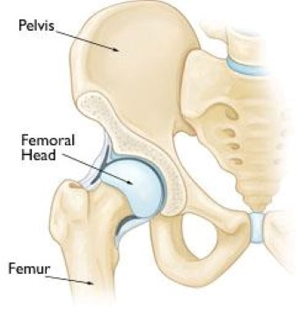
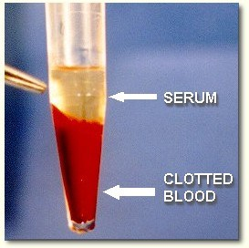
Research Goal
To develop a diagnostic tool for bone metabolic diseases by quantitatively measuring Ca isotopes in serum.

Slide 4
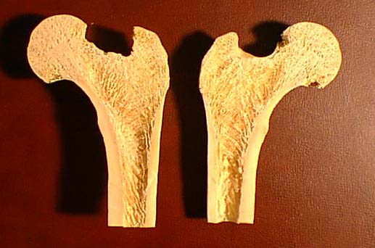
Trabecular
Cortical

Slide 5
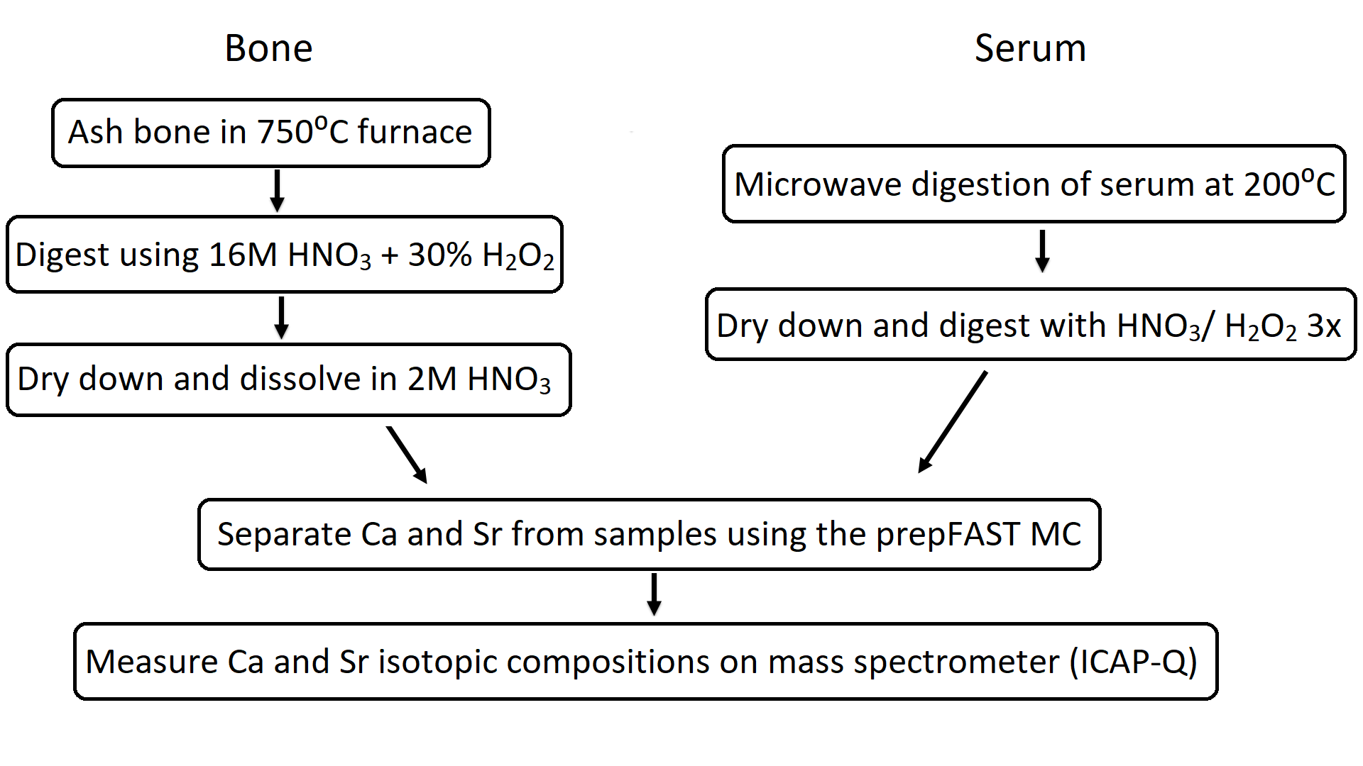
Methods

Slide 6
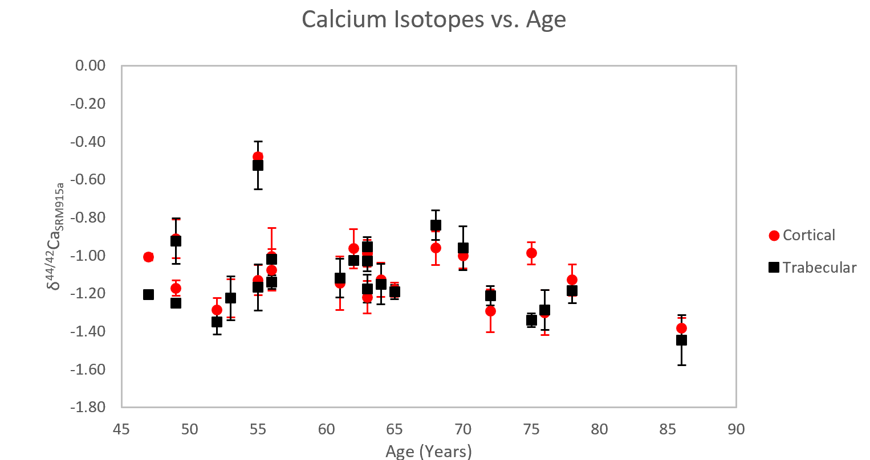
Calcium Isotopes of Cortical and Trabecular Bone

Slide 7
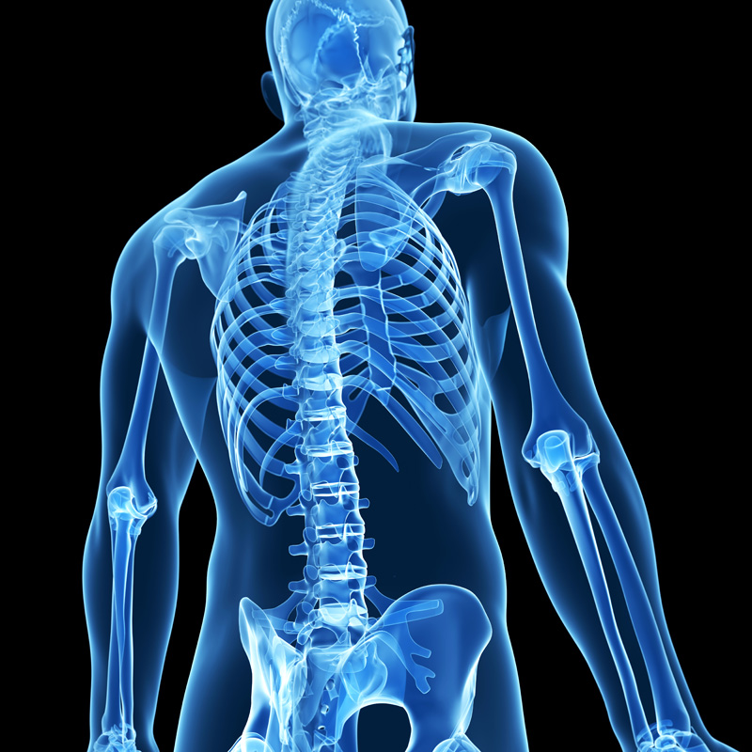
Conclusion
Cortical and trabecular bone from each individual display similar shifts in Ca isotope.
Changes in bone mineral density occur uniformly throughout the bone.
Next step: measure fractionation in serum and compare it to bone.

Slide 8

Acknowledgements
Steve Romaniello, Assistant Research Scientist at ASU
Wang Zheng, Research Scientist at ASU
Gwyneth Gordon, Assistant Research Professor at ASU
Ariel Anbar, President’s Professor at ASU
ASU/NASA Space Grant

